Slide 1

20 Years of Educated Lives
Measuring the Impact of Higher Education on Notability
Anthony Chua Biology
Máté Hekfusz Computer Science
Toby Lê Film and New Media, History

Slide 2
Background

Slide 3

Does a “good education” increase one’s chances at notability?
Good: subjective, but we take the Times Higher Education (THE) 2020 World University Rankings list as our measure of a university’s relative strength
Education: formal schooling at an undergraduate institution
Notability: being included in the Brief History of Human Time database
Notes:
Times Higher Education: https://www.timeshighereducation.com/world-university-rankings/2020/world-ranking
methodology: https://www.timeshighereducation.com/world-university-rankings/world-university-rankings-2020-methodology

Slide 4
Scope of Time: Persons Born 1940-1960
Justification: More pragmatic, More historically appropriate
The University became more widespread, less elitist, and more secular in the 19th century, consequently any type of analysis should not occur before this period [1]
Most existing ranking systems were created in the 20th century [2]
Record keeping became more standardized and organized in the 20th century
Want to maximize the sample size of educated individuals and university attendance grew dramatically from the 60s - 80s [3]
University became increasingly inclusive in these decades to include more students from marginalized groups [4]
Notes:
The University became more widespread, less elitist, and more secular in the 19th century, consequently any type of analysis should not occur before this period [1]
Most existing ranking systems were created in the 20th century [2]
Record keeping became more standardized and organized in the 20th century
Want to maximize the sample size of educated individuals and university attendance grew dramatically from the 60s - 80s [3]
University became increasingly inclusive in these decades to include more students from marginalized groups [4]

Slide 5

Scope of Sector: Higher Education of Any Field
Any degree-granting program
We are examining if attending a “better” institution can affect one’s notability, thus all levels are considered
Alumni will enter a variety of fields, so all sectors will be considered

Slide 6
Scope of Place: Worldwide
Alumni can come from any country, and can work in any country (theoretically)
Prestigious universities exist all over the world
We recognize that most are clustered in the West

Slide 7
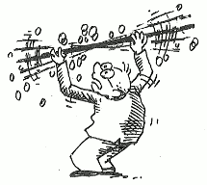
Data: Notables, Universities, Almae Matres
Data we used:
Brief History of Human Time database of notable people
THE 2020 university rankings
Education (alma maters) of people in that database
Scraped from Wikidata/Wikipedia and added to the notable people database
Ages of each university
How we used the data:
Basic statistics (gender, areas of attachment, etc.)
Linear regression
x: THE 2020 World University Ranking of university
y: ln(average rank of notables from university × number of notables from university ÷ age of university)

Slide 8
Assumptions and Biases
THE 2020 World University Rankings
The THE rankings have been criticised for undervaluing non-science and non-English universities
Notables
Many notable university graduates may not have their alma mater listed on their Wikipedia page. To maintain consistency and minimise guesswork, these people will have to be excluded
Potential for using sources other than Wikipedia
Some persons may have become notable before attending a university

Slide 9
Data Troubles
Phrasing inconsistencies (“MIT” vs “Massachusetts Institute of Technology”)
Notable universities with several colleges
Oxford, Cambridge, etc.
Fuzzy rankings beyond a certain point
Ex.: 201-250 as one ranking rather than fifty different rankings

Slide 10
Results

Slide 11
Going through the Notable People
22103 entries provided from 436 (!) countries
Roughly 10.5 hours of parsing time
9367 with their higher education listed on Wikidata (42.3%)
Differences in chunks (65.7% to 20.4%)

Slide 12
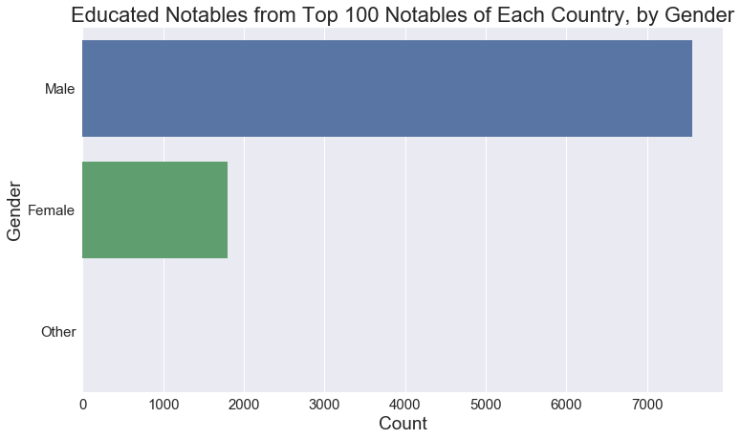

Slide 13
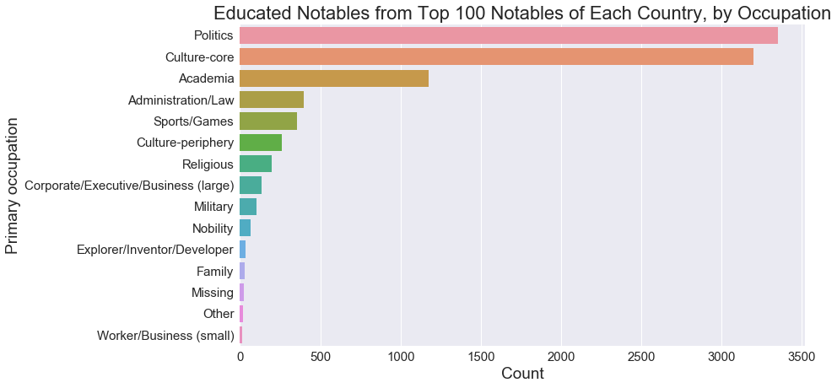

Slide 14
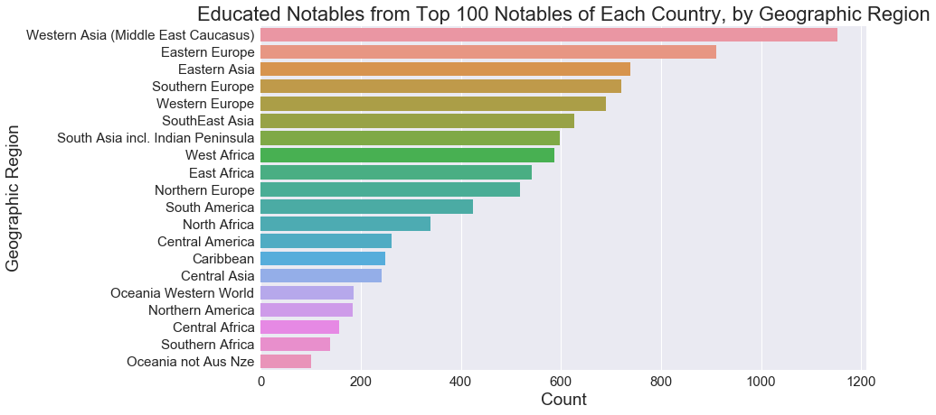

Slide 15
Going through the Universities
1396 entries from 92 different countries/regions
Focus on top 200 universities, as ranked by THE

Slide 16
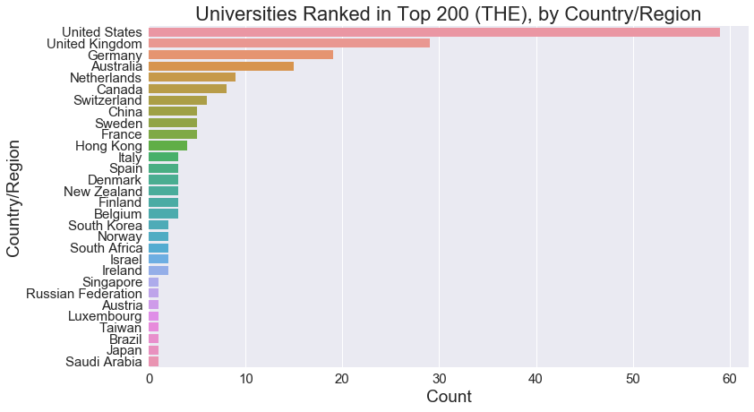

Slide 17
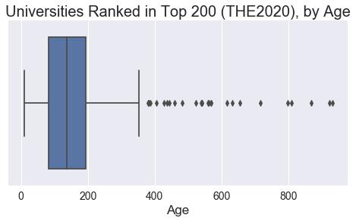
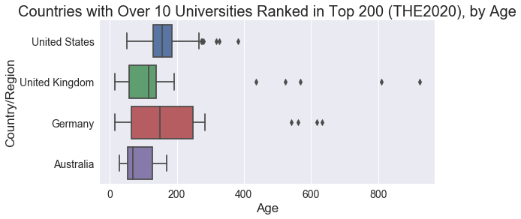

Slide 18
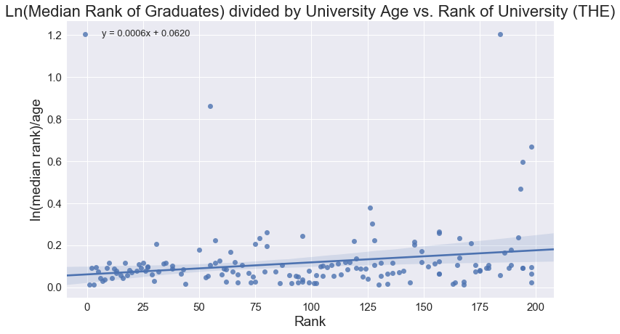
R²=0.057

Slide 19
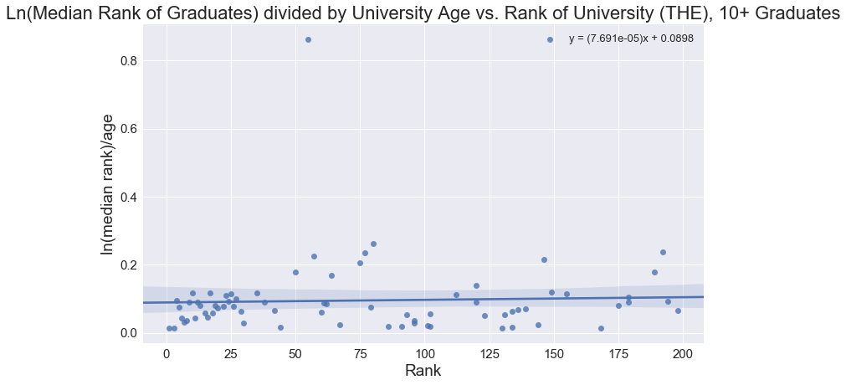
n=72
R²=0.002

Slide 20
So, Where Do I Send My Child for University?
If the aim is notability, then it does not seem to matter for the top 200 universities.
Directions for future studies
Maybe it matters for universities below the top 200
Maybe different professions are affected differently
Maybe the location of the university plays a role
Does higher education have no effect, or was our range of universities too small?

Slide 21


Fin
Questions?
Notes:
Motivation: What makes a good university?
Background on history of higher education
Origin and motivation
Where they were and are common
Emphasis on 20th century CE
University ranking systems
Origin and motivation
Who uses them
Variables usually taken into account
Question: Does a “good education” increase one’s chances at notability?
Methods
Details on THE 2020 World University Rankings (variables, biases, etc.)
Linear regression
Results and Discussion
Universities of noteworthy output
Conclusion: Where to send your kids?
Next project: Is having kids worth it?
Data collection: writing code for web scraping, building our database (Nov 17 - Nov 30)
Data manipulation: plotting regressions, building top lists, etc. (Nov 30 - Dec 7)
Writing the final essay (Dec 7 - Dec 15)
Presentation (Dec 16)

Slide 22
References
Anderson, R. (2010). The ‘Idea of a University’ today. History & Policy, 1, 22-26.
Aziz, H. (2016). Strength and weakness of varsity rankings. Retrieved from https://www.nst.com.my/news/2016/09/172958/strength-and-weakness-varsity-rankings.
Brockliss, L., & Sheldon, N. (Eds.). (2012). Mass education and the limits of state building, c. 1870-1930. Springer.
Kerr, C. (1991). The great transformation in higher education, 1960-1980. SUNY Press.
Roser, M., & Ortiz-Ospina, E. (2013). Tertiary Education. Retrieved December 17, 2019, from https://ourworldindata.org/tertiary-education.

